Slide 1

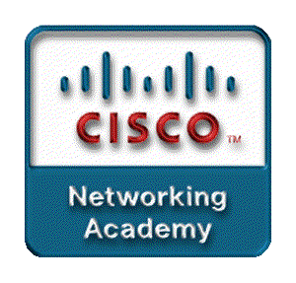
Chapter 4
Network Security
Part I

Slide 2
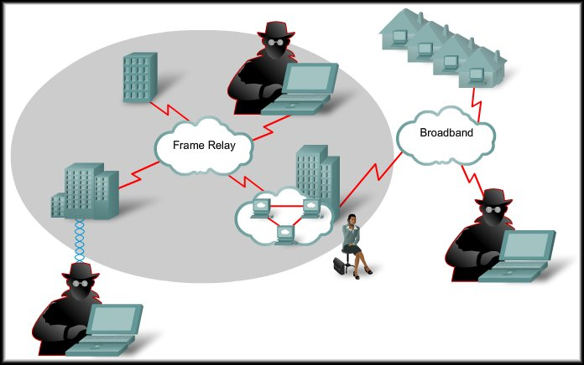
Introducing Network Security
Introduction to Network Security

Slide 3
Introducing Network Security
Why is Network Security important?
  Rapid growth in both size and importance.
  Consequences of compromised security:
    Loss of privacy.
    Theft of information.
    Legal liability.

Slide 4
Introducing Network Security
Why is Network Security important?
  We will discuss:
    Different types of threats.
    Development of organizational security policies, mitigation techniques,
    Cisco software tools to help secure networks.
    Managing Cisco IOS software images.
      Cisco software images and configurations can be deleted. Devices compromised in this way pose security risks.

Slide 5
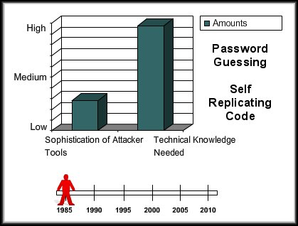
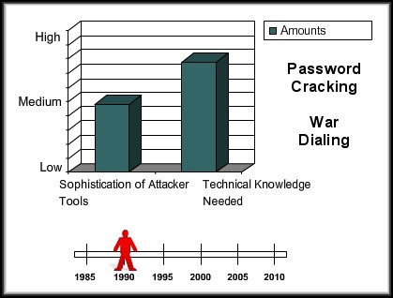
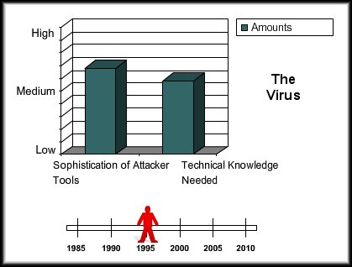
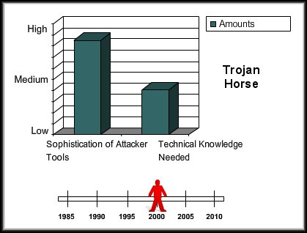
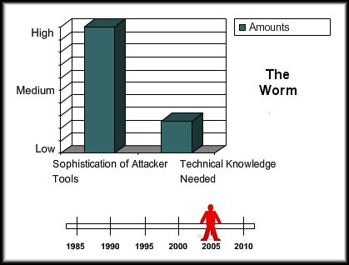
Introducing Network Security
Increasing Threat to Security:
  Over the years, attack tools have evolved.
  Threats become more sophisticated as the technical expertise required to implement attacks diminishes.

Slide 6



Introducing Network Security
Common Terms:
  White Hat:
    An individual who looks for vulnerabilities in systems and reports these so that they can be fixed.
  Black Hat:
    An individual who uses their knowledge to break into systems that they are not authorized to use.
  Hacker:
    A general term that has historically been used to describe a computer programming expert.

Slide 7




Introducing Network Security
Common Terms:
  Cracker:
    Someone who tries to gain unauthorized access to network resources with malicious intent.
  Phreaker:
    Individual who manipulates phone network, through a payphone, to make free long distance calls.
  Spammer:
    An individual who sends large quantities of unsolicited e-mail messages.
  Phisher:
    Uses e-mail or other means to trick others into providing information.

Slide 8
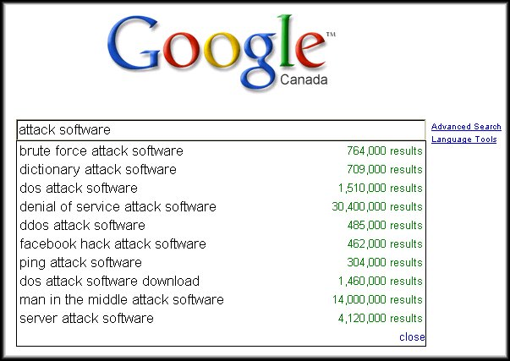
Introducing Network Security
Think Like an Attacker:
  Step 1. Perform footprint analysis (reconnaissance).
  Step 2. Enumerate information.
  Step 3. Manipulate users to gain access.
  Step 4. Escalate privileges.
  Step 5. Gather additional passwords and secrets.
  Step 6. Install backdoors.
  Step 7. Leverage the compromised system.
Sounds like it’s complicated and the software is not easily available.

Slide 9

These are the most commonly reported acts of computer crime:
Insider abuse of access | Denial of service | Key logging
Viruses | Unauthorised access to data | Website defacement
Mobile device theft | Bots within an organisation | Exploiting DNS server
Phishing | Theft or customer data | Telecom fraud
IM misuse | Abuse of wireless network | Sabotage

Slide 10
Introducing Network Security
Types of computer crime:
  Text and Curriculum lists the most commonly reported acts of computer crime that have network security implications.
  They fall into four general categories, or a combination thereof, that effective and vigilant security management can address.
    Insider Abuse
    Denial of service
    System Penetration
    Password sniffing

Slide 11
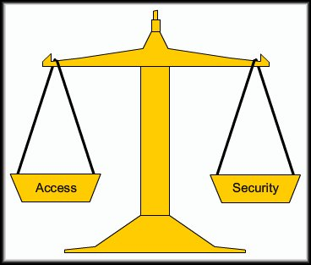
Introducing Network Security
Open versus Closed Networks:
  The challenge is to find the correct balance.
    Networks must be accessible to be of any use.
    Networks must be secure to protect corporate and personal information.

Slide 12

The scales are balanced to create more restrictive access
Security benefits, but there are some drawbacks:
  More difficult to configure and administer
  More difficult for end users to access data
  Security costs are greater than for an open systems

Slide 13

The scales are tipped toward security and the network may be closed completely to the outside world.
Connectivity is usually only granted to know, trusted third parties
A closed network has the same drawbacks as a restrictive network and is also the most expensive to implement

Slide 14

The scales are tipped to provide open access to users
Security risks are self-evident, but there are some advantages:
  Easy to configure and setup
  Easy for end users to access resources
  Security costs are much less

Slide 15
Introducing Network Security
Developing a Security Policy:
  First step an organization should take to protect its data and a liability challenge.
  A security policy meets these goals:
    Informs users, staff, and managers of their requirements for protecting information assets.
      Acceptable and unacceptable use.
    Specifies the mechanisms through which these requirements can be met.
      Managing security violations.
    Provides a baseline from which to acquire, configure, and audit computer systems for compliance.
      Basis for legal action.

Slide 16
Common Security Threats
Three common factors - Network Security:
  Vulnerability:
    It is the degree of weakness which is inherent in every network and device.
        Routers, switches, desktops, and servers.
  Threats:
    They are the people interested in taking advantage of each security weakness.
  Attack:
    The threats use a variety of tools, and programs to launch attacks against networks.

Slide 17
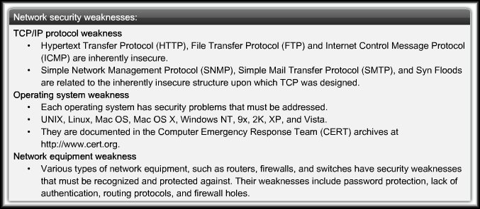
Vulnerabilities
Three primary Vulnerabilities or Weaknesses:
  Technological weaknesses.
    Computer and network technologies have intrinsic security weaknesses.

Slide 18
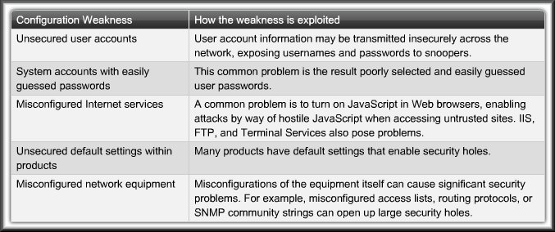
Vulnerabilities
Three primary Vulnerabilities or Weaknesses:
  Configuration weaknesses.
    Network administrators or network engineers need to learn what the configuration weaknesses are and correctly configure their computing and network devices to compensate.

Slide 19
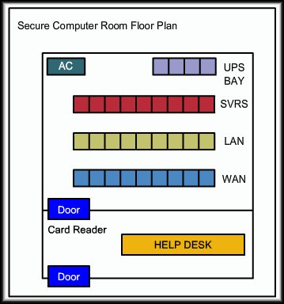
Threats to Physical Infrastructure
Four classes of Physical Threats:
  Hardware Threat:
    Physical damage to servers, routers, switches, cabling plant, and workstations.
  Security Measures:
    Lock up equipment and
    prevent unauthorized
    access.
    Monitor wiring closet
    access – electronic logs.
    Security cameras

Slide 20
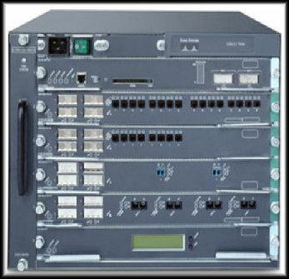
Threats to Physical Infrastructure
Four classes of Physical Threats:
  Environmental Threat:
    Temperature or humidity extremes.
  Security Measures:
    Temperature control.
    Humidity control.
    Positive air flow.
    Remote environment
    alarms.

Slide 21
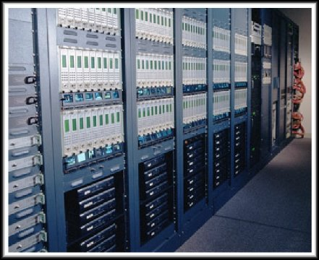
Threats to Physical Infrastructure
Four classes of Physical Threats:
  Electrical Threat:
    Voltage spikes, insufficient voltage (brownouts), unconditioned power (noise), and total power loss.
  Security Measures:
    UPS systems.
    Generators.
    Preventive maintenance.
    Redundant power
    supply.
    Remote alarms.

Slide 22
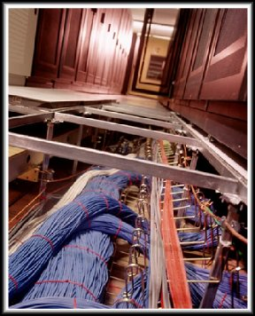
Threats to Physical Infrastructure
Four classes of Physical Threats:
  Maintenance:
    Poor handling of key electrical components, lack of critical spare parts, poor cabling, and poor labeling.
  Security Measures:
    Neat cable runs.
    Label the cables.
    Electrostatic discharge
    procedures.
    Stock critical spares.
    Control console port access.

Slide 23
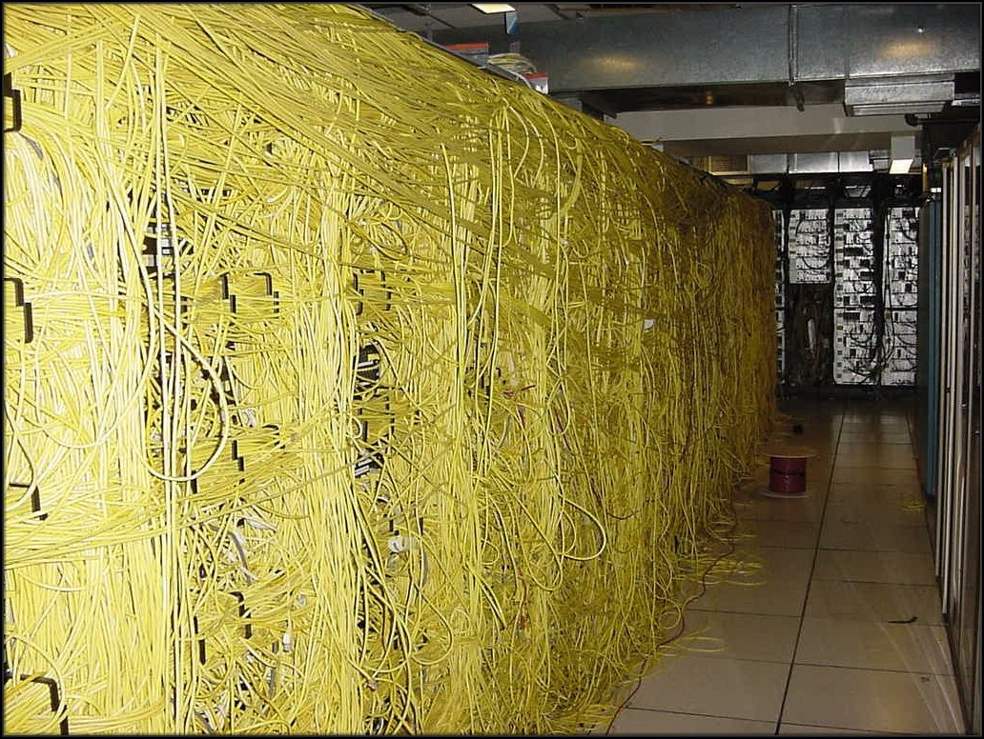
Threats to Physical Infrastructure
Four classes of Physical Threats:
  Maintenance:
    Poor handling of key electrical components, lack of critical spare parts, poor cabling, and poor labeling.
  You probably want to avoid this……

Slide 24
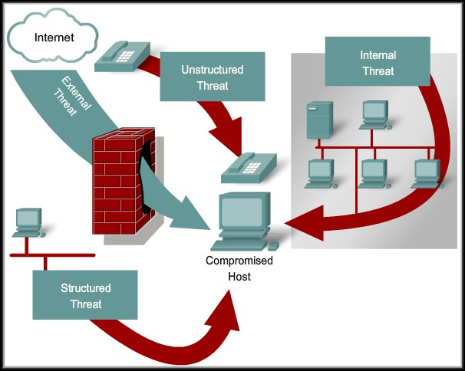
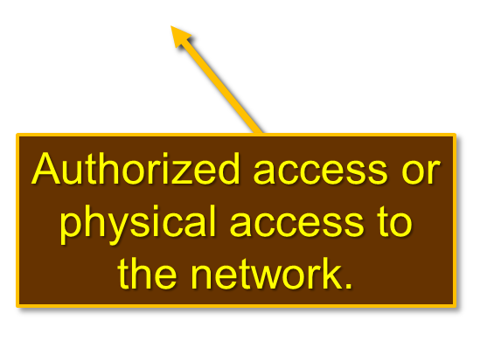
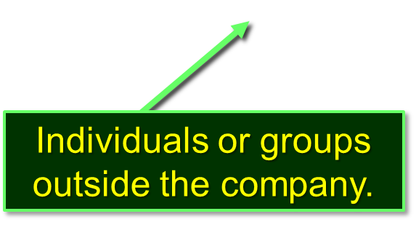
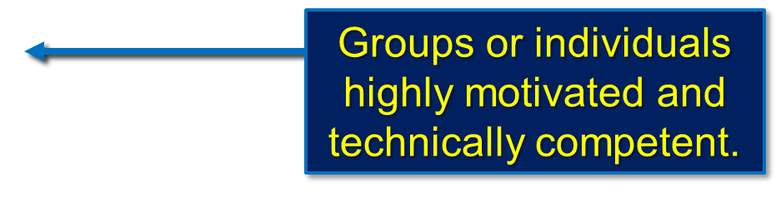
Threats to Networks
Inexperienced individuals with easily available hacking tools.
Network Threats:

Slide 25
Social Engineering
The easiest hack involves no computer skill.
  If an intruder can trick a member of an organization into giving over information, such as the location of files or passwords, the process of hacking is made much easier.
Phishing:
  A type of social engineering attack that involves using
  e-mail in an attempt to trick others into providing sensitive information, such as credit card numbers or passwords.
  Phishing attacks can be prevented by educating users and implementing reporting guidelines when they receive suspicious e-mail.

Slide 26
Types of Network Attacks
There are four primary classes of attacks:
  Reconnaissance
  Access
  Denial of Service
  Malicious Code

Slide 27

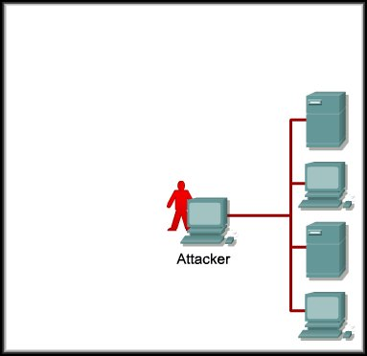
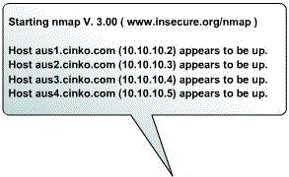
Types of Network Attacks
Reconnaissance:
  Reconnaissance is the
  unauthorized discovery
  and mapping of
  systems, services,
  or vulnerabilities.
  In most cases,
  it precedes another
  type of attack.

Slide 28

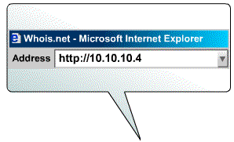
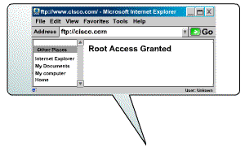
Types of Network Attacks
System Access:
  System access is the
  ability for an intruder
  to gain access to a
  device for which the
  intruder does not have
  an account or a
  password.
  Usually involves
  running a hack, script,
  or tool that exploits
  a known vulnerability
  of the system or application being attacked.

Slide 29

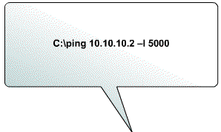

Types of Network Attacks
Denial of Service:
  Denial of service (DoS)
  is when an attacker
  disables or corrupts
  networks, systems,
  or services with the
  intent to deny services
  to intended users.
  DoS attacks involve
  either crashing the
  system or slowing it
  down to the point that
  it is unusable. DoS MOST FEARED!

Slide 30

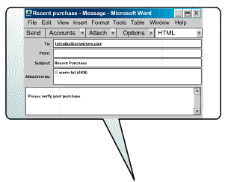
Types of Network Attacks
Worms, Viruses and
Trojan Horses:
  Malicious software
  can be inserted
  onto a host to
  damage or corrupt
  a system, replicate
  itself, or deny
  access to networks,
  systems, or services.

Slide 31
Types of Network Attacks
Reconnaissance Attacks:
  Reconnaissance is the unauthorized discovery or mapping of systems, services or vulnerabilities.
  It usually precedes another type of attack.
  Can consist of:
    Internet Information Queries
    Ping Sweeps
    Port Scans
    Packet Sniffers

Slide 32

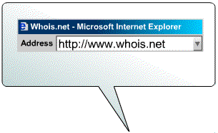
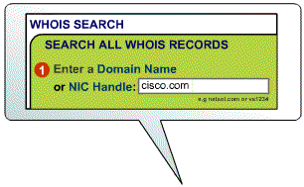
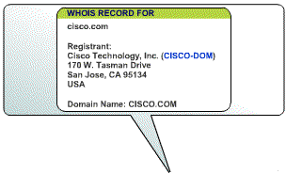
Types of Network Attacks
Internet Queries:
  External attackers can
  use Internet tools,
  such as the nslookup
  and whois utilities,
  to easily determine
  the IP address space
  assigned to a given
  corporation or entity.

Slide 33

Types of Network Attacks
Ping Sweeps:
  After the IP address
  space is determined,
  an attacker can then
  ping the publicly
  available IP addresses
  to identify the
  addresses that are
  active.
  To help automate this
  step, an attacker
  may use a ping sweep
  tool, such as fping or gping.

Slide 34

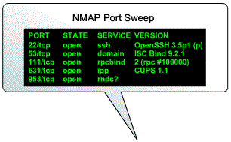
Types of Network Attacks
Port Scans:
  When the active IP
  addresses are
  identified, the intruder
  uses a port scanner to
  determine which
  network services or
  ports are active on the
  live IP addresses.
  A port scanner is
  software, such as
  Nmap or Superscan,
  that is designed to search a network host for open ports.

Slide 35

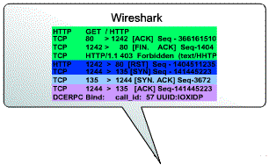

Types of Network Attacks
Packet Sniffers:
  Internal attackers may
  attempt to "eavesdrop“
  on network traffic.
  Wire Shark
  Two common uses
  of eavesdropping are
  Information Gathering
  and/or
  Information Theft.

Slide 36
Types of Network Attacks
Packet Sniffers:
  A common method for eavesdropping is to capture TCP/IP or other protocol packets and decode the contents.
  Three of the most effective methods for counteracting eavesdropping are as follows:
    Using switched networks instead of hubs so that traffic is not broadcast to all endpoints or network hosts.
    Using encryption that meets the data security needs without imposing an excessive burden on system resources or users.
    Forbid the use of protocols with known susceptibilities to eavesdropping. (e.g. SNMP vs SNMP v3)

Slide 37
Types of Network Attacks
Access Attacks:
  Access attacks exploit vulnerabilities in authentication, FTP, and web to gain entry to accounts, confidential, and sensitive information.
  The more common are:
    Password Attacks
    Trust Exploitation
    Port Redirection
    Man-in-the-Middle

Slide 38
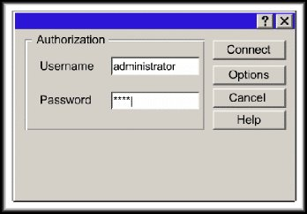
Types of Network Attacks
Password Attacks:
  Packet sniffer to yield user
  accounts and passwords that are
  transmitted as clear text.
  Dictionary Attacks or Brute-Force Attacks:
    Repeated attempts to log in to a shared resource.
    Tools such as L0phtCrack or Cain.
    Rainbow Tables:
      A rainbow table is pre-computed series of passwords which is constructed by building chains of possible plaintext passwords.
    Password attacks can be mitigated by educating users to use long, complex passwords.

Slide 39

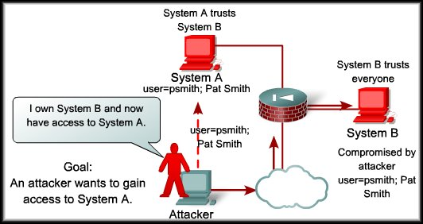
Types of Network Attacks
Trust Exploitation:
  The goal of a trust exploitation attack is to compromise a trusted host, using it to stage attacks on other hosts in a network.

Slide 40
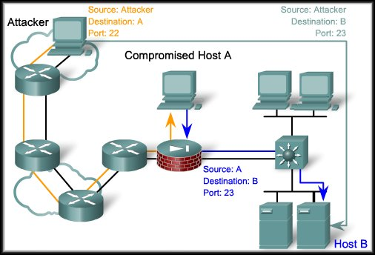
Types of Network Attacks
Port Redirection:
  Port redirection is a type of trust exploitation attack that uses a compromised host to pass traffic through a firewall. Traffic that would normally be stopped.
  Utility - netcat
  Port redirection can
  be mitigated through
  the use a host-based
  Intrusion Detection
  System (IDS).
  (e.g. Snort)

Slide 41
Types of Network Attacks
Man-in-the-Middle:
  A man-in-the-middle (MITM) attack is carried out by attackers that manage to position themselves between two legitimate hosts.
  There are many ways that an attacker gets positioned between two hosts.
  One popular method, the transparent proxy:
    In a transparent proxy attack, an attacker may catch a victim with a phishing e-mail or by defacing a website.
    Then the URL of a legitimate website has the attacker’s URL prepended.
  http:www.attacker.com/http://www.legitimate.com

Slide 42
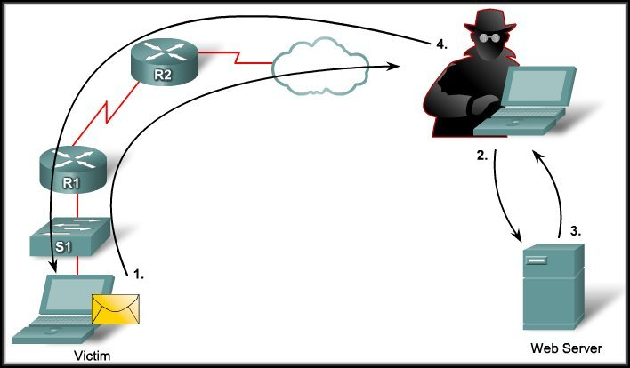
Types of Network Attacks
Man-in-the-Middle:
Attacker can make any changes.
Attacker forwards the ‘changed’ page to the victim.
Attacker’s host receives the request and fetches the real page.
Victim clicks link in a phish email.

Slide 43
Types of Network Attacks
Denial-of-Service Attacks:
  An attacker disables or corrupts networks, systems or services with the intent to deny service to intended users.
  DoS attacks are the most publicized form of attack and also among the most difficult to eliminate.
    Ping of Death
    SYN Flood
    DDos
    Smurf

Slide 44
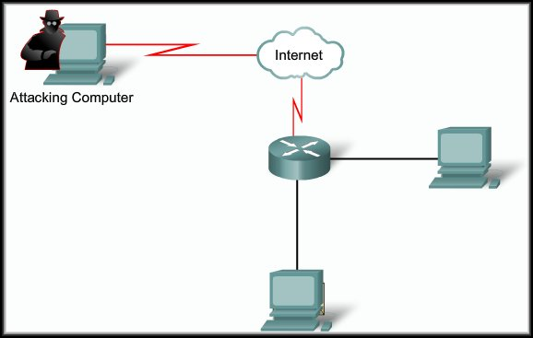

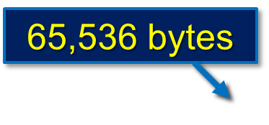

Types of Network Attacks
Older OS – most networks no longer susceptible.
Denial-of-Service Attacks:
  This attack modified the IP portion of a ping packet header to indicate that there is more data in the packet than there actually was.
Ping – 64 to 84 bytes
Buffer overrun…
System crashes…

Slide 45
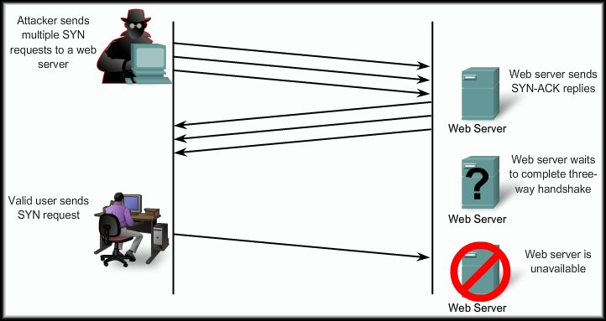

Types of Network Attacks
Denial-of-Service Attacks:
  This attack exploits the TCP three-way handshake.
Connection buffer reaches maximum.
No More connects….
Prevention:
Firewall completes the handshake and forwards the server response.
SYN Flood

Slide 46

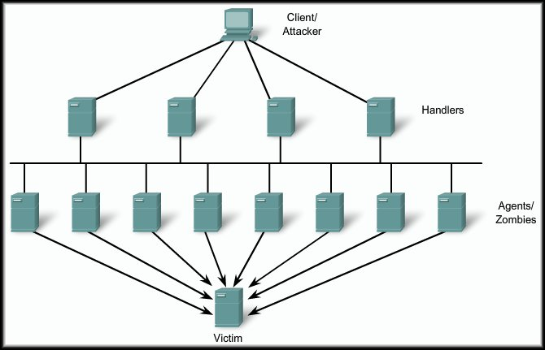


Types of Network Attacks
Denial-of-Service Attacks:
  Overwhelm network links with illegitimate data.
Compromised - attacker’s program
One Handler can control several Zombies.

Slide 47
Smurf Attack
This attack relies on a perpetrator sending a large amount of ICMP echo request (ping) traffic to IP broadcast addresses, all of which have a spoofed source IP address of the intended victim.
If the routing device delivering traffic to those broadcast addresses delivers the IP broadcast to all hosts (for example via a layer 2 broadcast), most hosts on that IP network will take the ICMP echo request and reply to it with an echo reply, multiplying the traffic by the number of hosts responding.
On a multi-access broadcast network, hundreds of machines might reply to each packet.

Slide 48
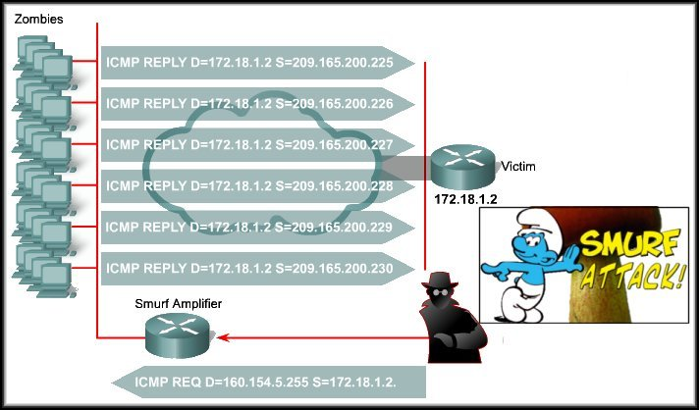
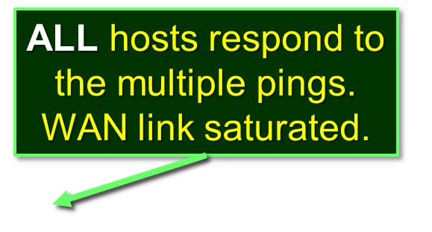

Types of Network Attacks
Denial-of-Service Attacks:
  Overwhelm WAN links with illegitimate data.
Turn off directed broadcasts.
Default - Rel. 12.0
Layer 3 to Layer 2 broadcast.

Slide 49
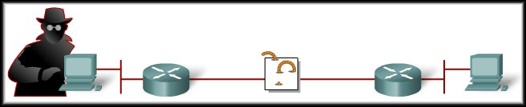

Types of Network Attacks
Malicious Code Attacks:
  Worm:
    Executes code and installs copies of itself in the memory of the infected computer, which can, in turn, infect other hosts.

Slide 50
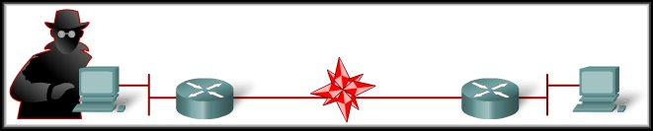

Types of Network Attacks
Malicious Code Attacks:
  Virus:
    Malicious software that is attached to another program for the purpose of executing a particular unwanted function on a workstation.

Slide 51
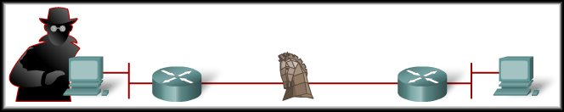
Types of Network Attacks
Malicious Code Attacks:
  Trojan Horse:
    Different from a worm or virus only in that the entire application was written to look like something else, when in fact it is an attack tool.

Slide 52
General Mitigation Techniques
Device Hardening:
  Default usernames and passwords should be changed.
  Access to system resources should be restricted to only the individuals that are authorized.
  Any unnecessary services should be turned off.
Antivirus Software.
Personal Firewalls.
OS Patches.

Slide 53
General Mitigation Techniques
Intrusion Detection and Prevention:
  Intrusion Detection Systems (IDS):
    Detect attacks against a network and send logs to a management console.
  Intrusion Prevention Systems (IPS):
    Prevent attacks against the network and should provide the following active defense mechanisms in addition to detection:
      Prevention….Stops the detected attack from executing.
      Reaction…..Immunizes the system from future attacks from a malicious source.

Slide 54
General Mitigation Techniques
Common Security Appliances and Applications:
  A firewall by itself is no longer adequate for securing a network.
  Integrated approach with a firewall, intrusion prevention, and VPN.
  Follows these building blocks:
    Threat Control: Regulates network access, prevents intrusions, by counteracting malicious traffic.
    Secure Communications: Secures network endpoints with a VPN.
    Network Admission Control (NAC): Provides a roles-based method of preventing unauthorized access.

Slide 55
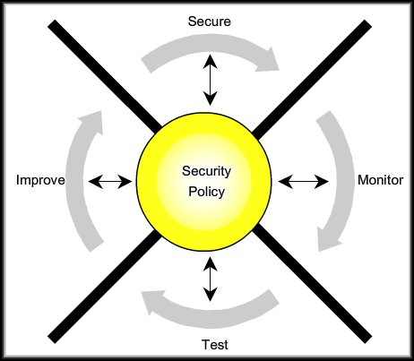
The Network Security Wheel
A continuous process and an effective approach.
Develop a Security Policy.
Identify objectives.
Document resources.
Current infrastructure.
Critical resources
(Risk Assessment).

Slide 56
The Network Security Wheel
A continuous process and an effective approach.
1
Threat Defense
IPS
OS Patches
Disable unnecessary services.
Filter traffic
VPNs (encrypted)
Trusts
User Authentication
Policy Enforcement

Slide 57
The Network Security Wheel
A continuous process and an effective approach.
1
Active and passive methods.
Active:
  Audit host logs
Passive:
  IDS
2

Slide 58
The Network Security Wheel
A continuous process and an effective approach.
1
Verify the methods implemented in Steps 1 and 2.
Vulnerability assessment tools:
  SATAN
  Nessus
  Nmap
2
3

Slide 59
The Network Security Wheel
A continuous process and an effective approach.
1
Using the information from steps 2 and 3, implement improvements.
2
4
3

Slide 60
The Enterprise Security Policy
A living document:
  The document is never finished and is continuously updated as technology and employee requirements change.
Essential Functions:
  Protects people and information.
  Sets the rules for expected behavior by users, system administrators, management, and security personnel.
  Authorizes security personnel to monitor, probe, and investigate.
  Defines and authorizes the consequences of violations.

